Slide 1
Utilizing Computer Vision for Waste Management
31st Annual Student Research Conference at Southeast Missouri State University
April 17th, 2023
Presenter: Tuyen Nguyen
Faculty Sponsor: Dr. Robert Lowe

Slide 2
Background and Context Consumerism
Changes in the ways goods were produced, sold, and advertised
Changes in the array of goods available and cherished
Redefinition of needs and aspirations
Inventions of department store, shopping mall, consumer credits
Tuyen Nguyen, Dept. Computer Science, Southeast Missouri State University
SEMO Student Research Conference, April 2023
Notes:
https://www.bu.edu/eci/files/2019/10/Consumption_and_Consumer_Society.pdf
The first concept that I would like to introduce in this background and context is the consumerism.
began to emerge in the late 19th and early 20th centuries
Due to the rise of industrialization, mass production, and advertisement
And changes in how people define their needs and aspirations

Slide 3
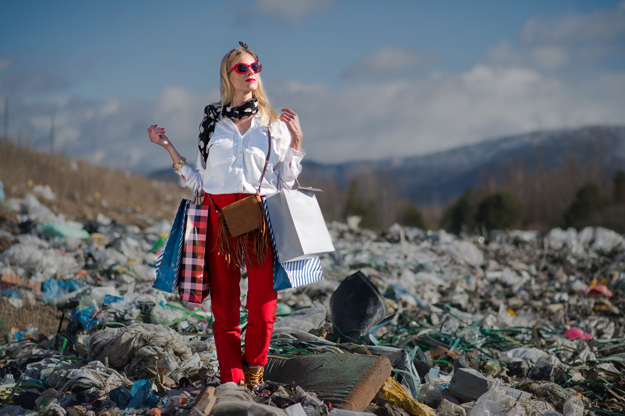
Background and Context Fast Fashion
Fast fashion refers to inexpensive clothing collections
Fashion companies use 10 washes as a benchmark for clothing durability (Joy et al.,2012).
The average American throws away about 37kg/81 pounds of clothes every year (EPA)
Microplastic pollution from washing synthetic clothes
85% of clothes (~13 mil ton) thrown away in the USA, 2017 are either dumped to landfill or burned (EPA)
Synthetics plastics(Polyester, nylon, acrylic) is not sustainable.
Synthetics fabrics make up about 60% of our clothes (Shui, 2013).
Tuyen Nguyen, Dept. Computer Science, Southeast Missouri State University
SEMO Student Research Conference, April 2023
Notes:
Fashion companies use ten washes as a benchmark for clothing durability, after which the material loses its original
The cheap fashion has contributed to the perception of clothing as disposable, with trends quickly passing and clothing being tossed to trash bins after just a few weeks or months.
that’s the weight of an 11-year-old child
1min
I am sure that many of us enjoy shopping and trying new styles, but have you ever thought where all that clothing goes after you have done with it. Will they be recycled?
Shui, S., & Plastina, A. (2013). World apparel fiber consumption survey. FAO and ICAC, Tech. Rep.
Synthetics fiber (Polyester, nylon, acrylic) all of which are forms of plastics. Plastics isn’t biodegradable, taking hundreds of year to break down
a single load of laundry could release hundreds of thousands of fibers from our clothes into the water supply (vox). These fibers when being released to the ocean can ingested by the marine species and accumulate the food chain

Slide 4



Background and Context Insufficient waste recycling and management
Amount of Municipal Solid Waste landfilled in USA, 2018
---
Landfill is the least environmentally preferable waste management strategy, especially for plastics (EPA, 2020)
17.5 MT paper
146.1 MT
26.3 MT plastic
16.1 MT leathers & textile
Tuyen Nguyen, Dept. Computer Science, Southeast Missouri State University
SEMO Student Research Conference, April 2023
Notes:
Now we understand about consumerism and that consumerism is not good for our environment (negative effects that I mentioned and those that I did not mention). One of the effect that I want to highlight is that consumerism generates tons of waste.
The problem become worsen as many countries around the world did not take enough actions in waste management, including Americ
16.07 MT leathers and textile (12%)
17.5 MT paper (12%)
1 min
These number shows that a huge amount of trash that we may think should be recycled were not recycled. They went to the soil and the ocean.
When things like plastic enter soil and ocean, it takes centuries to decompose, posing a threat to organisms in the environment through ingestion

Slide 5
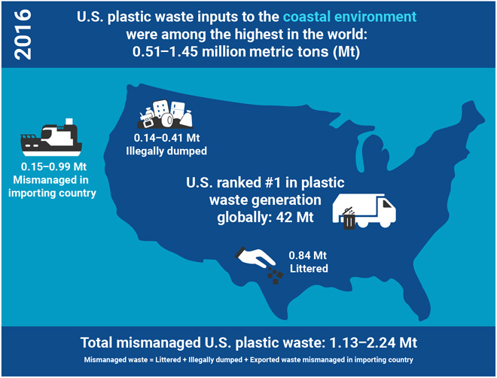
Background and Context Insufficient waste recycling and management
The United States’ contribution of plastic waste to land and ocean
Law et al., 2020
Tuyen Nguyen, Dept. Computer Science, Southeast Missouri State University
SEMO Student Research Conference, April 2023
Notes:
1.99 million metric tons of 3.91 million metric tons of plastics collected for recycling were shipped to other countries for processing, with 88 percent of this waste went to developing nations that lacks sufficient facility and resources to appropriately manage and process it.
30sec

Slide 6
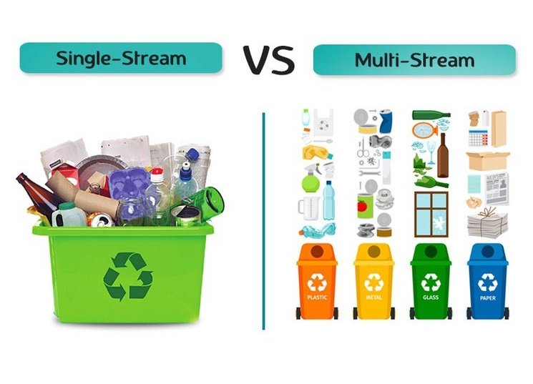
Background and Context Single Stream Recycling system for households
absence of practice of separating recyclable materials
increasing complexity of products and packaging
non-recyclables mistakenly thrown into recyclable bins
90% of all curbside programs use single stream recyclables collection.
(Tonjes et al., 2018)
Recyclables lose its recycling ability and
becomes waste
Tuyen Nguyen, Dept. Computer Science, Southeast Missouri State University
SEMO Student Research Conference, April 2023
Notes:
1.99 million metric tons of 3.91 million metric tons of plastics collected for recycling were shipped to other countries for processing, with 88 percent of this waste went to developing nations that lacks sufficient facility and resources to appropriately manage and process it.

Slide 7
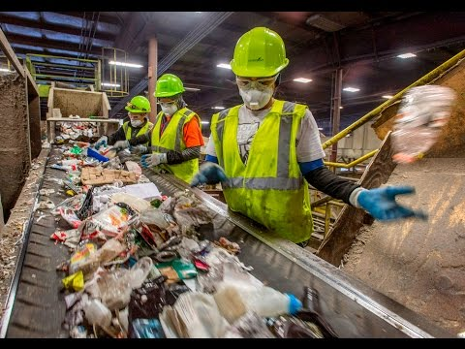
Background and Context Trash sorting at recycling plants
Tuyen Nguyen, Dept. Computer Science, Southeast Missouri State University
SEMO Student Research Conference, April 2023

Slide 8



Take this seriously
Consume less
Recycle more
Change to multi-stream recycling system
Use clothes made from natural fibers
Educate about recycling practices
…
What can we do to help our planet?
Technology can help too!
Tuyen Nguyen, Dept. Computer Science, Southeast Missouri State University
SEMO Student Research Conference, April 2023

Slide 9
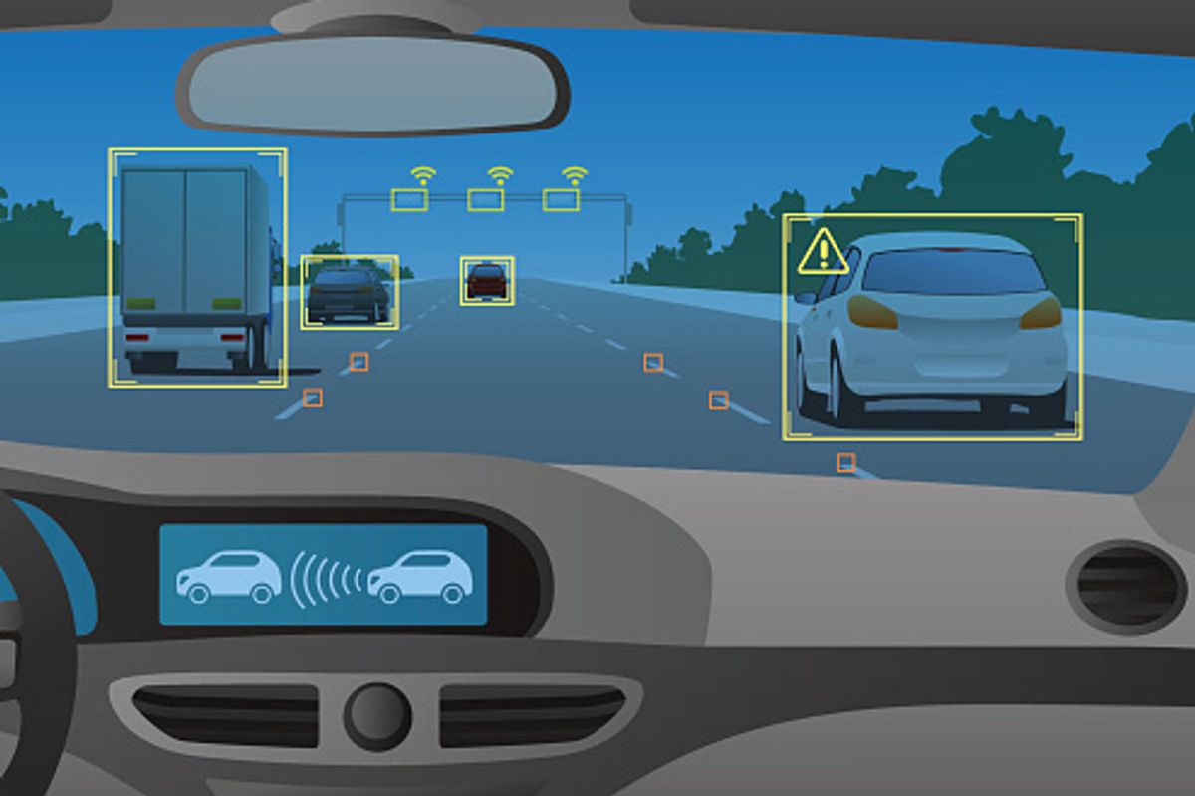

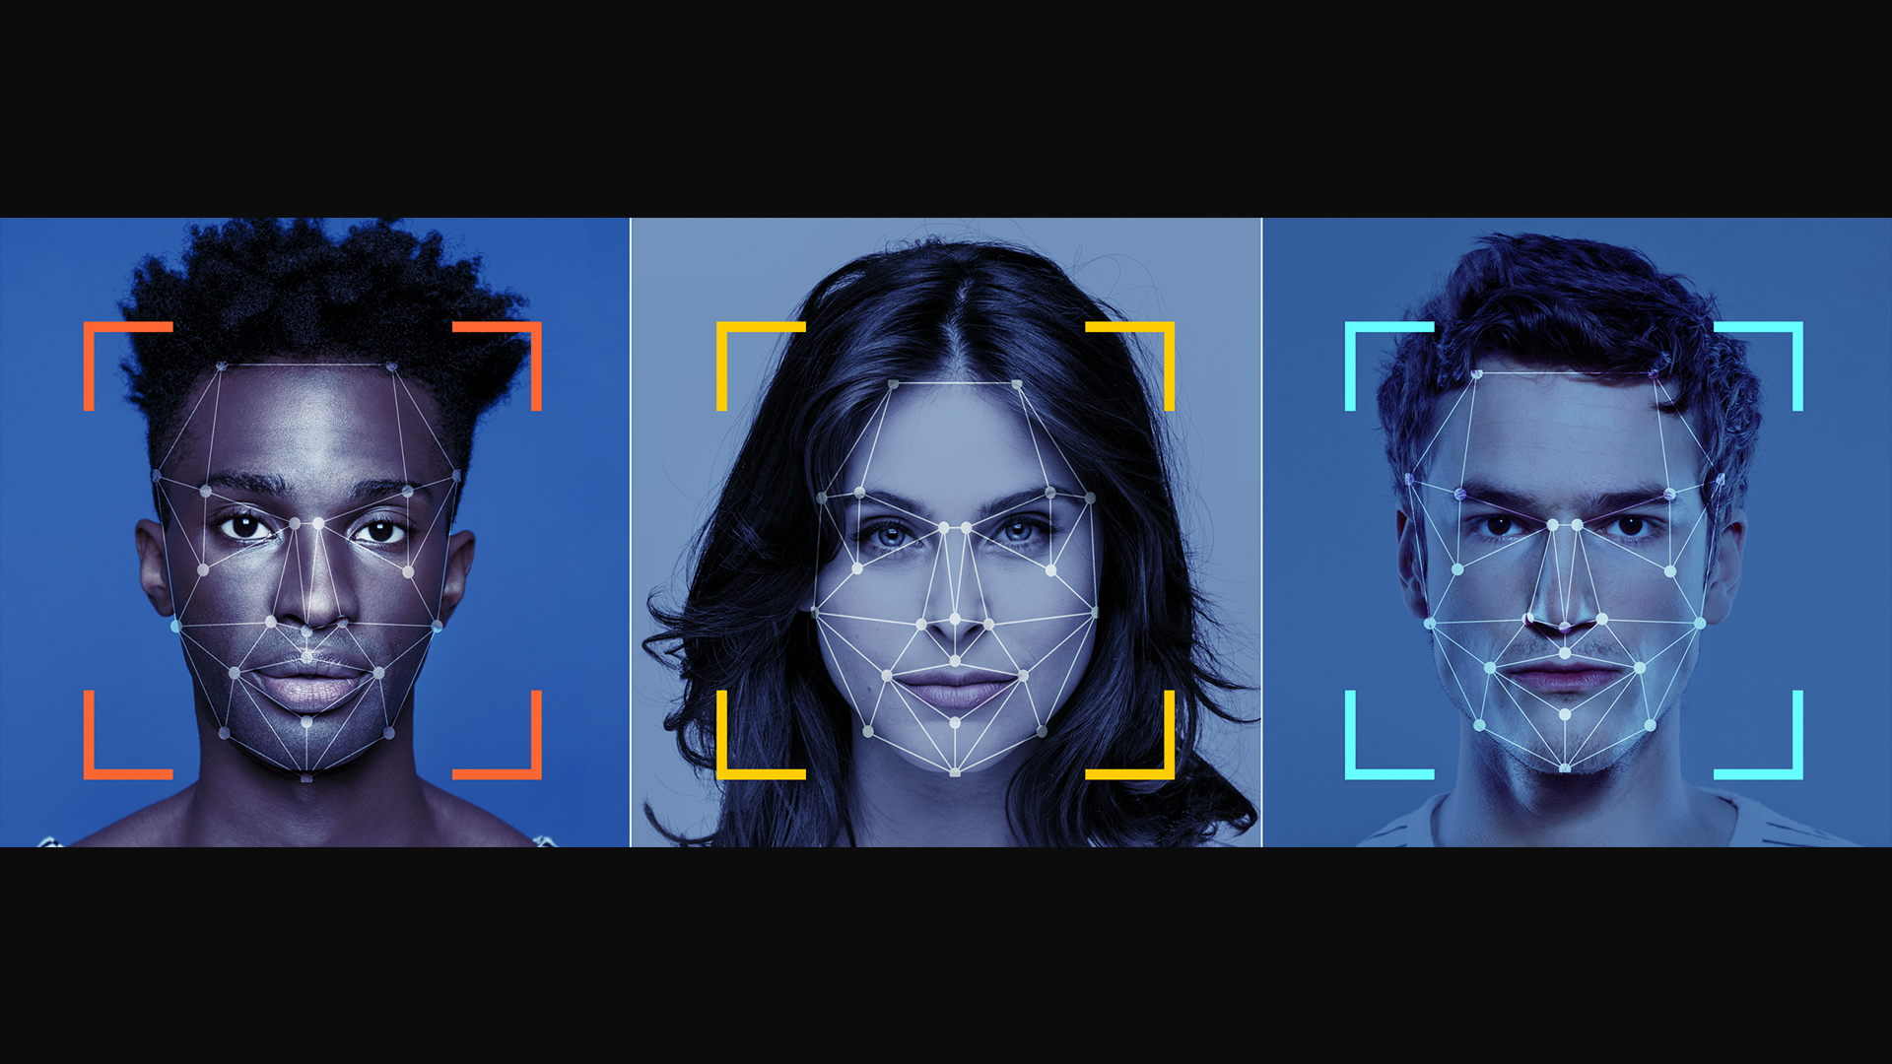
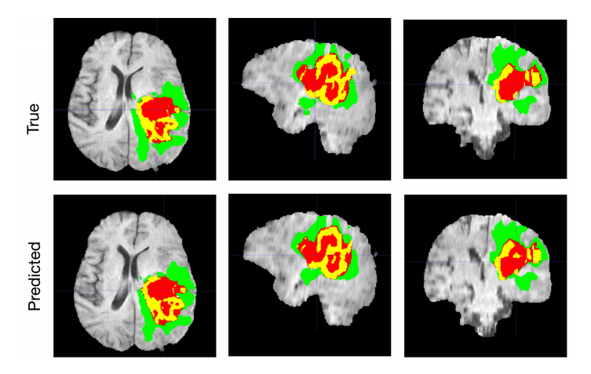
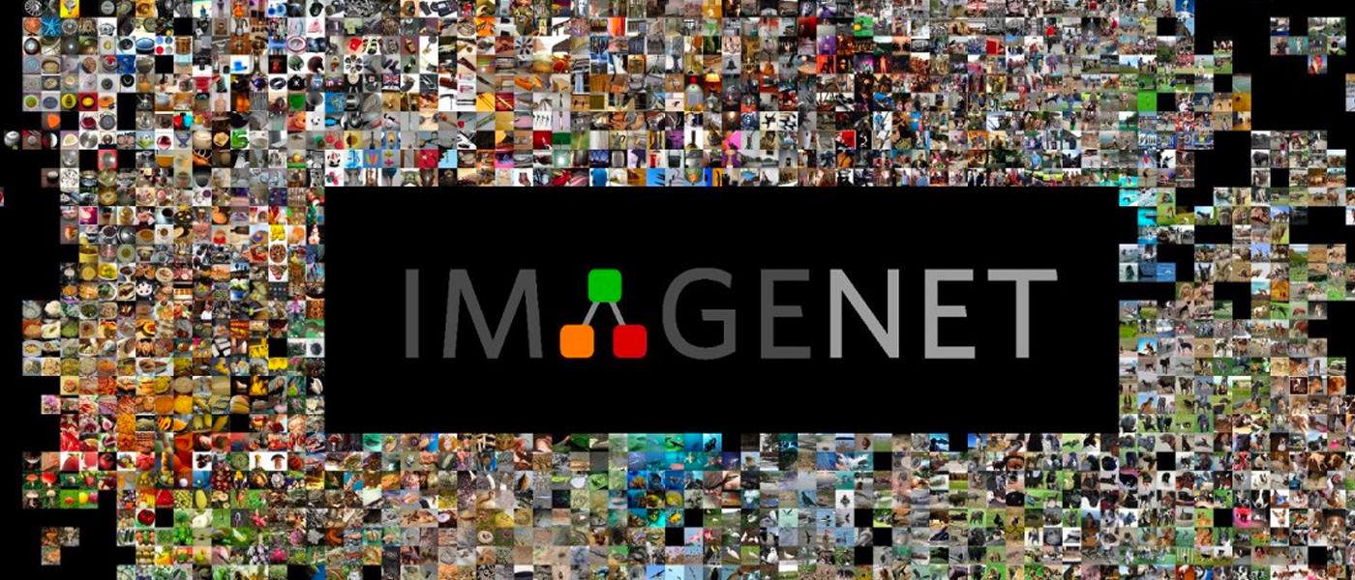

Background and Context Computer Vision and Convolutional Neural Network
Tuyen Nguyen, Dept. Computer Science, Southeast Missouri State University
SEMO Student Research Conference, April 2023
Notes:
In the mid 2010s,

Slide 10
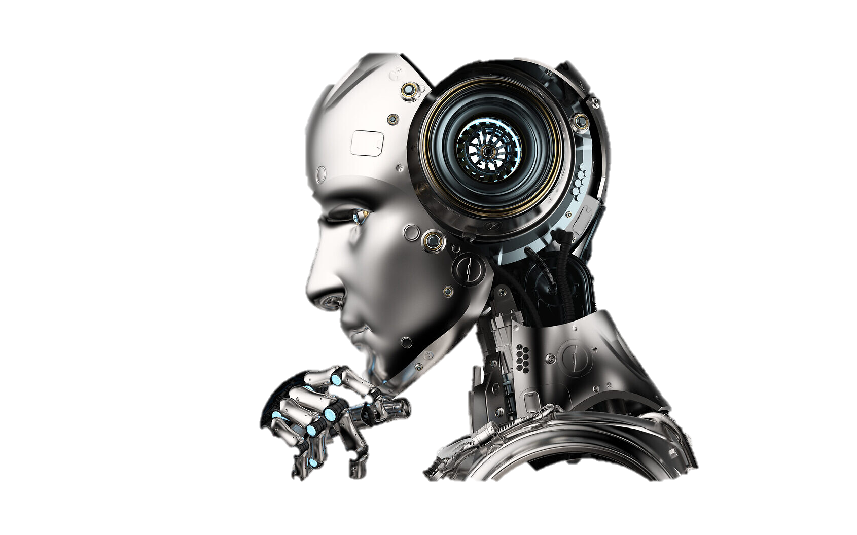
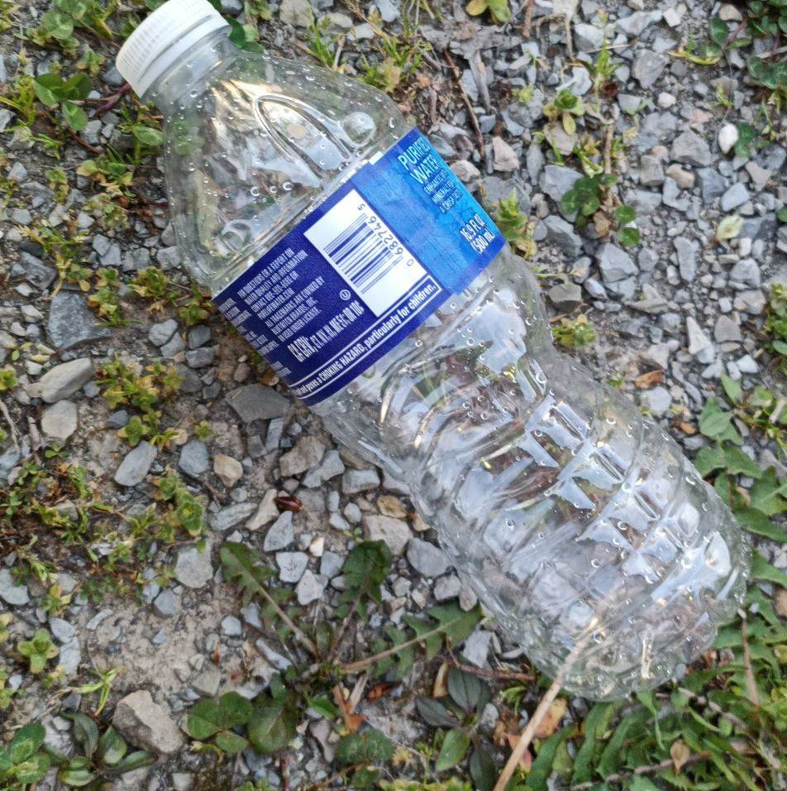
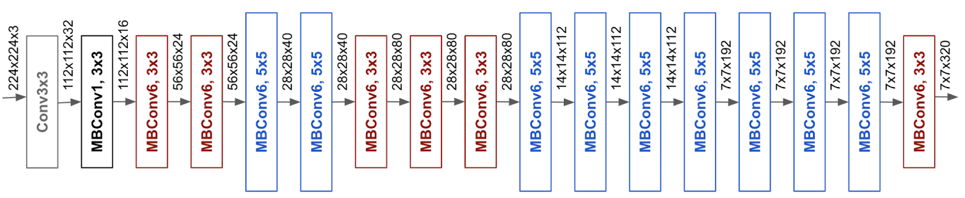
Problem Statement A Trash Classifier using Convolutional Neural Network
paper
glass
metal/plastic
unknown
bio
Non-recyclable
other
Tuyen Nguyen, Dept. Computer Science, Southeast Missouri State University
SEMO Student Research Conference, April 2023

Slide 11
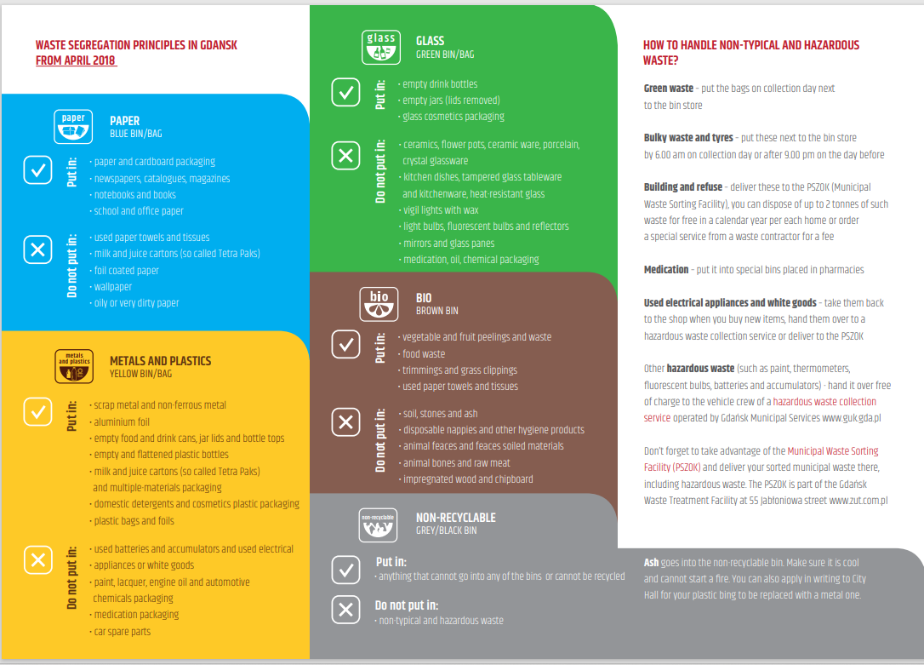
Tuyen Nguyen, Dept. Computer Science, Southeast Missouri State University
SEMO Student Research Conference, April 2023
Notes:
In the mid 2010s,

Slide 12


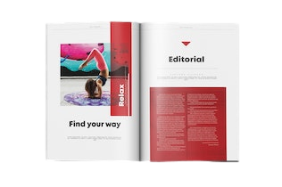
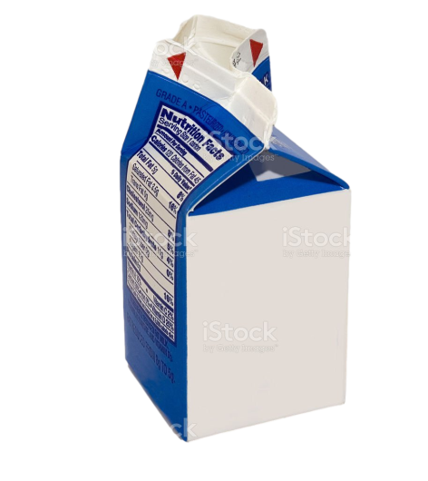
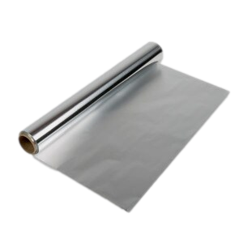
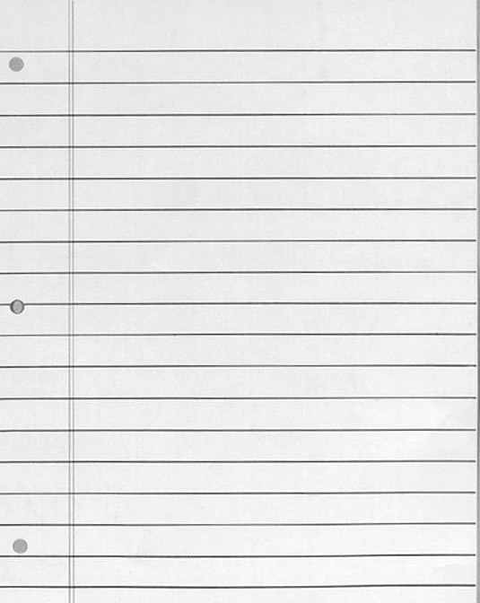

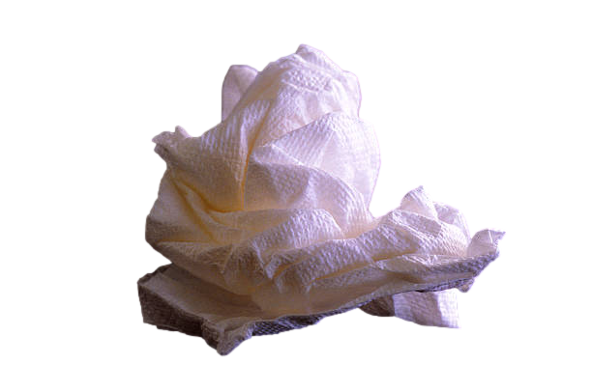
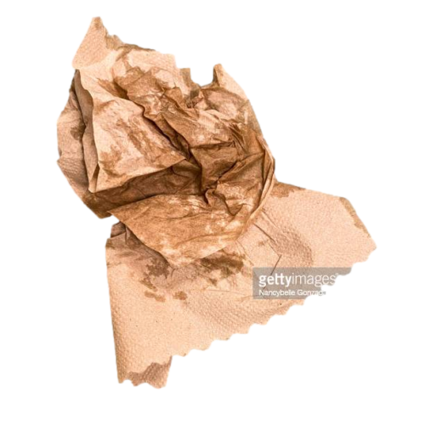
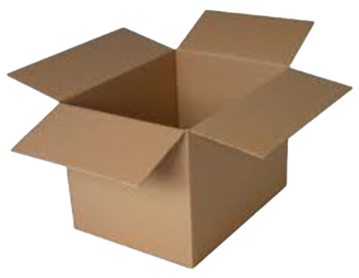

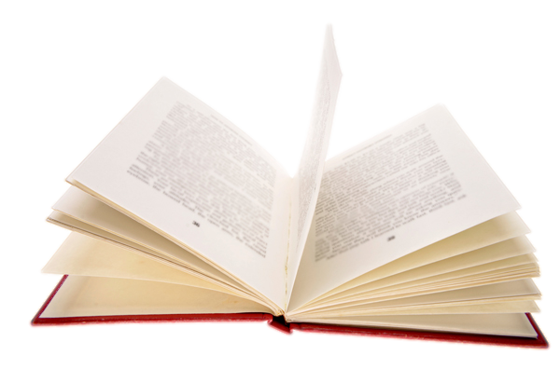
Put in
Not put in
paper
newspaper
magazine
Milk carton
Aluminum foil
Wallpaper
cardboard
notebook
book
Used tissue
Oily/dirty paper
Tuyen Nguyen, Dept. Computer Science, Southeast Missouri State University
SEMO Student Research Conference, April 2023

Slide 13

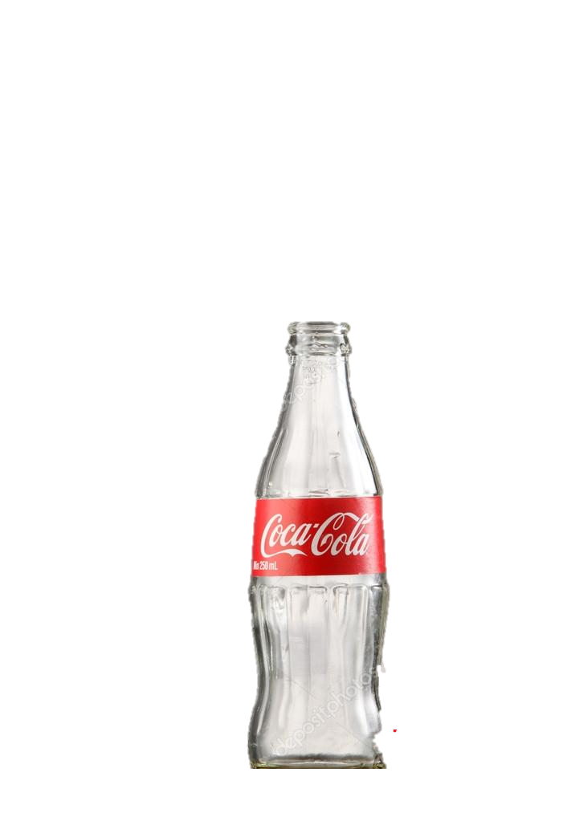
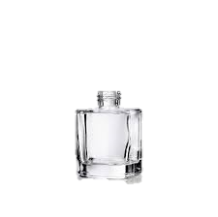
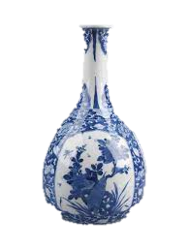
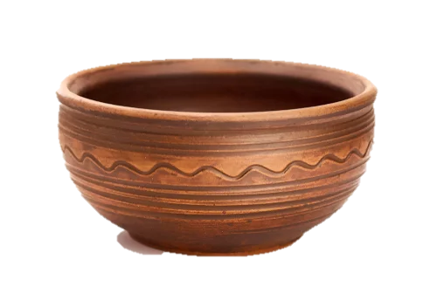
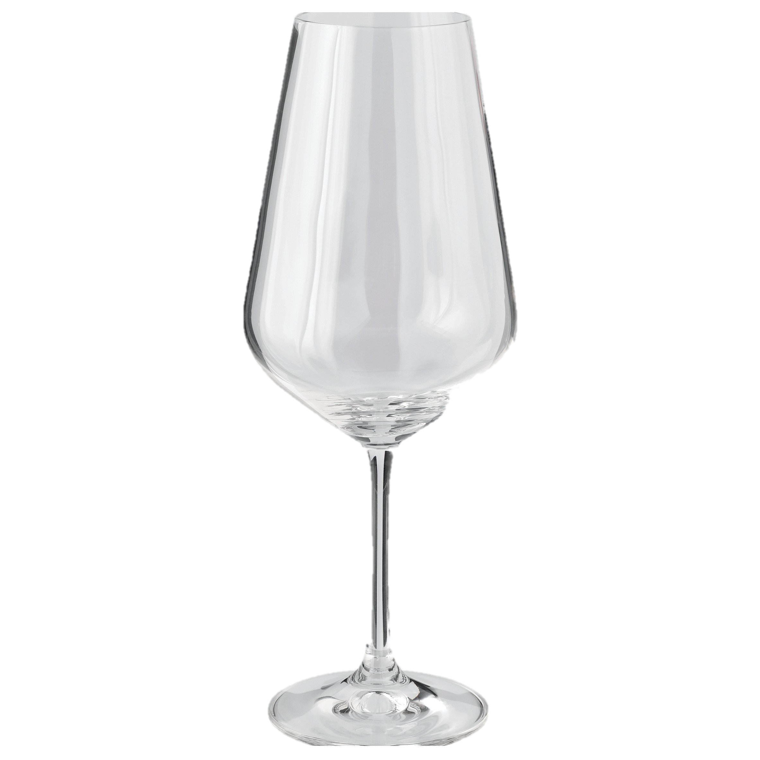
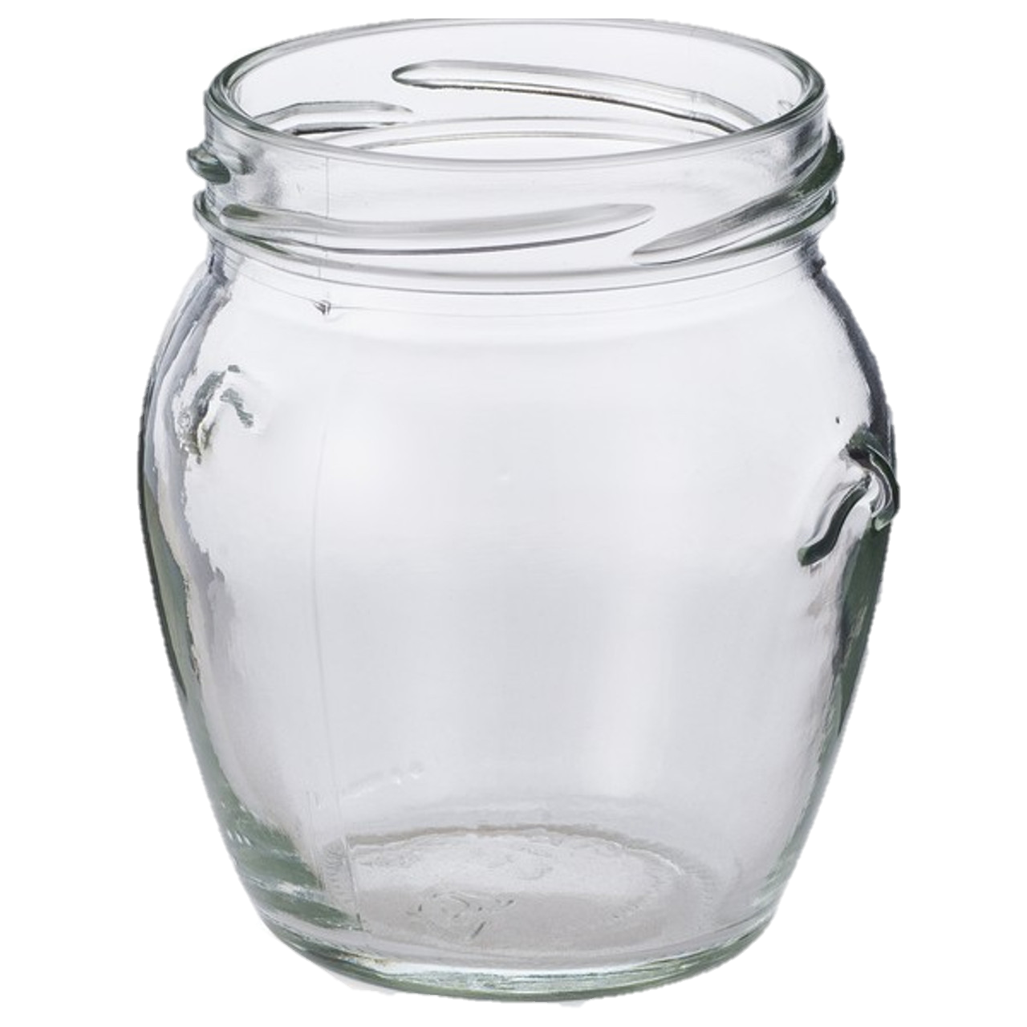
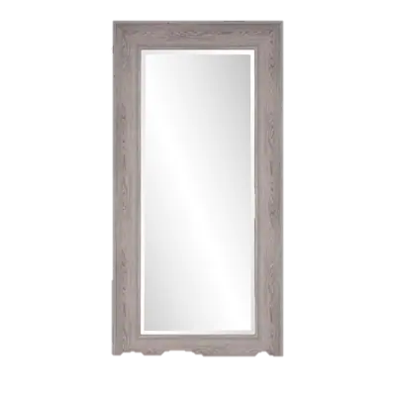
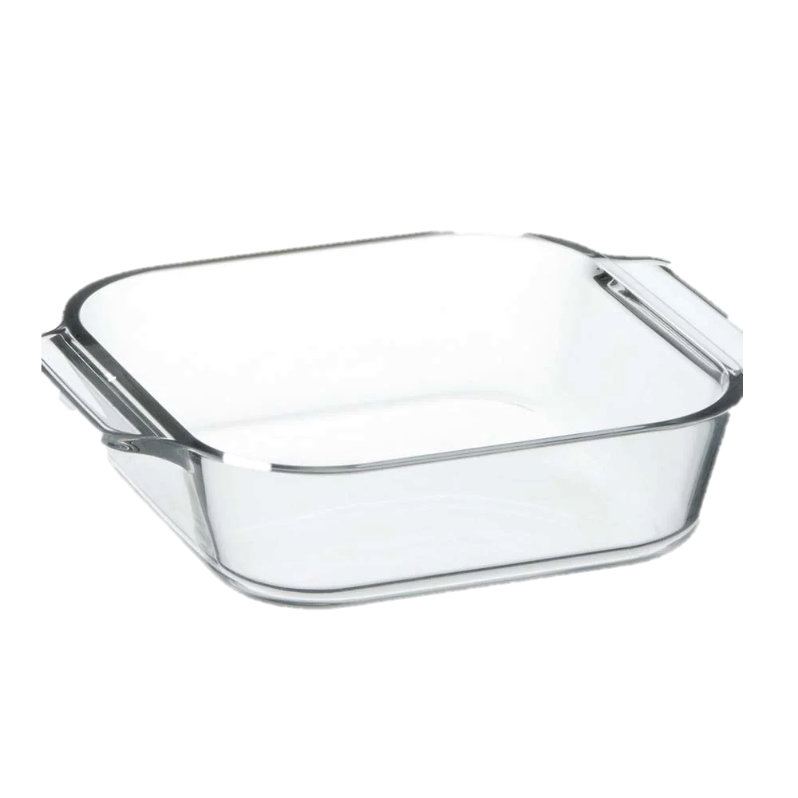
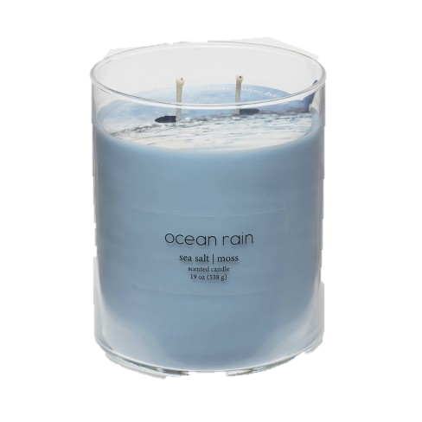
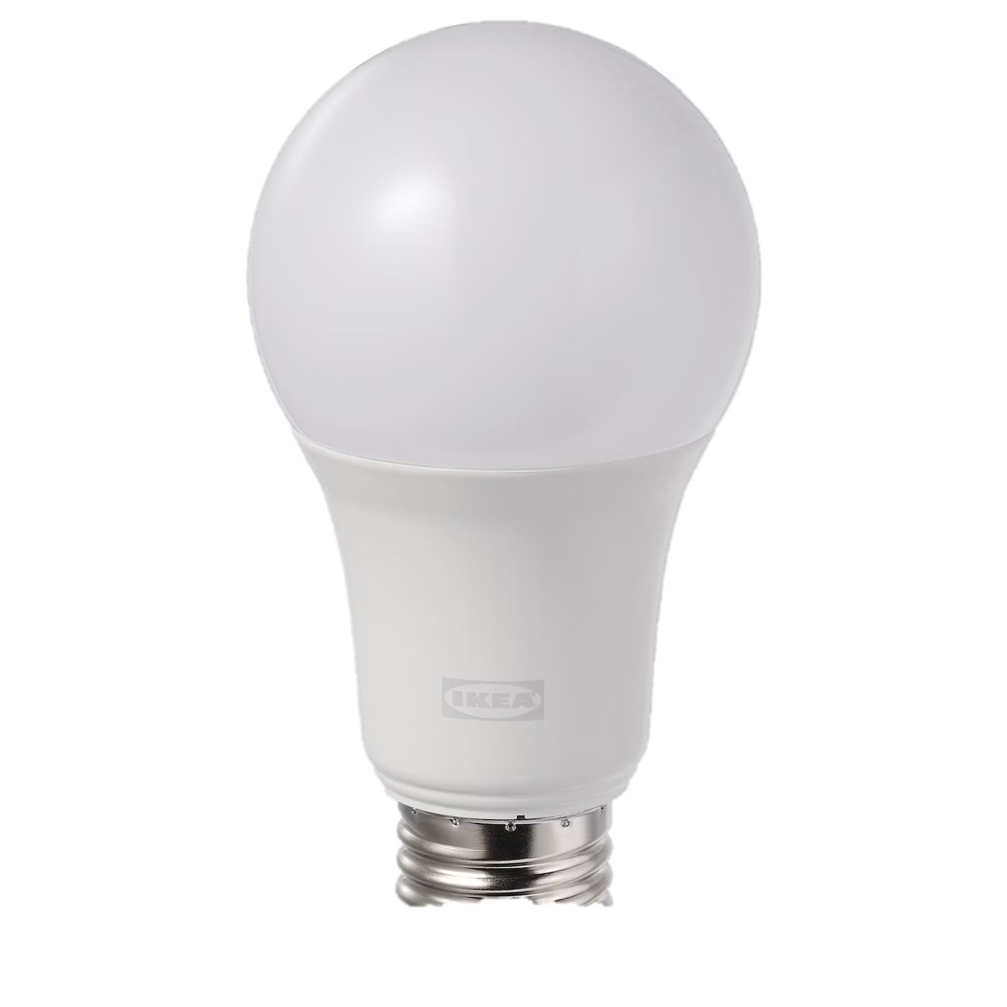
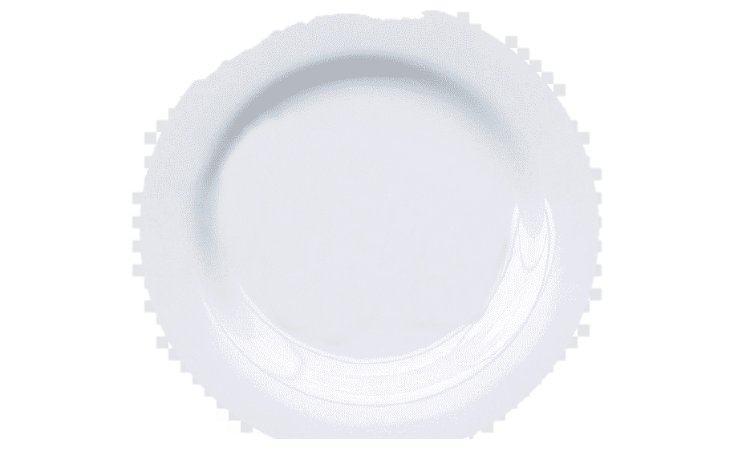
Put in
Not put in
Drink bottle
Jar (no lid)
Cosmetics packaging
Ceramics
Porcelain
Crystal glassware
Light bulb
Mirror
Tempered glass tableware
Heat resistant glass
Candle glass
Tuyen Nguyen, Dept. Computer Science, Southeast Missouri State University
SEMO Student Research Conference, April 2023

Slide 14

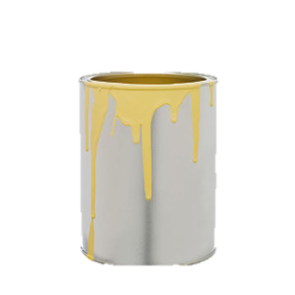
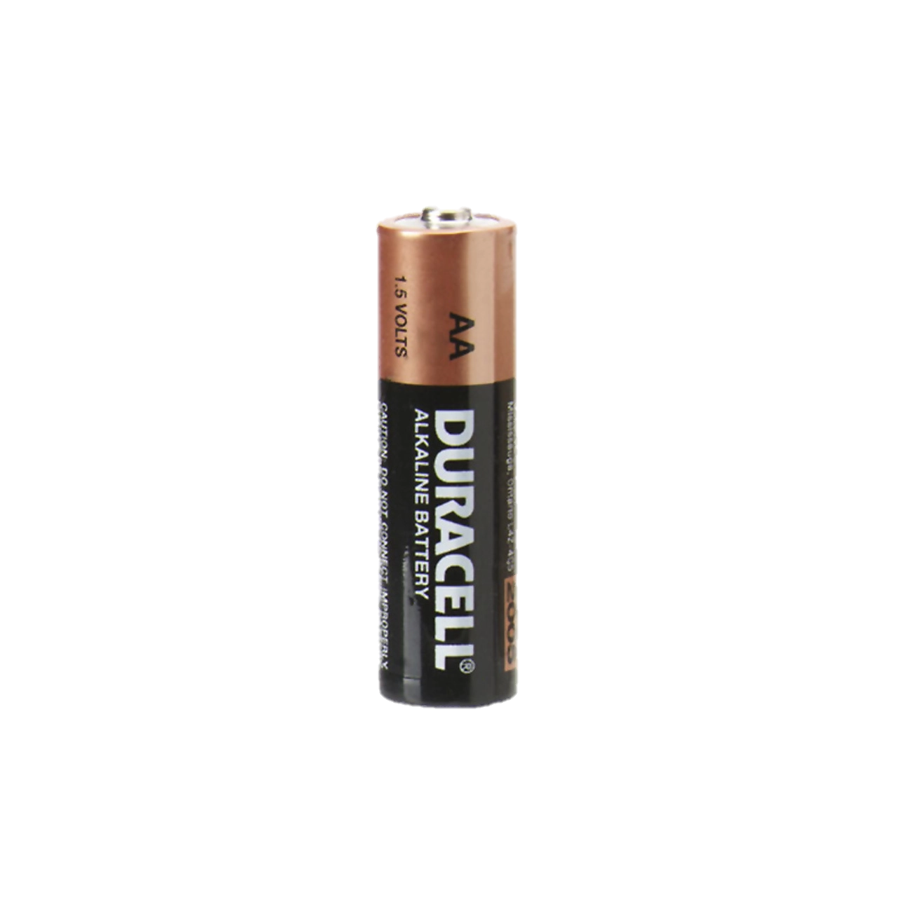
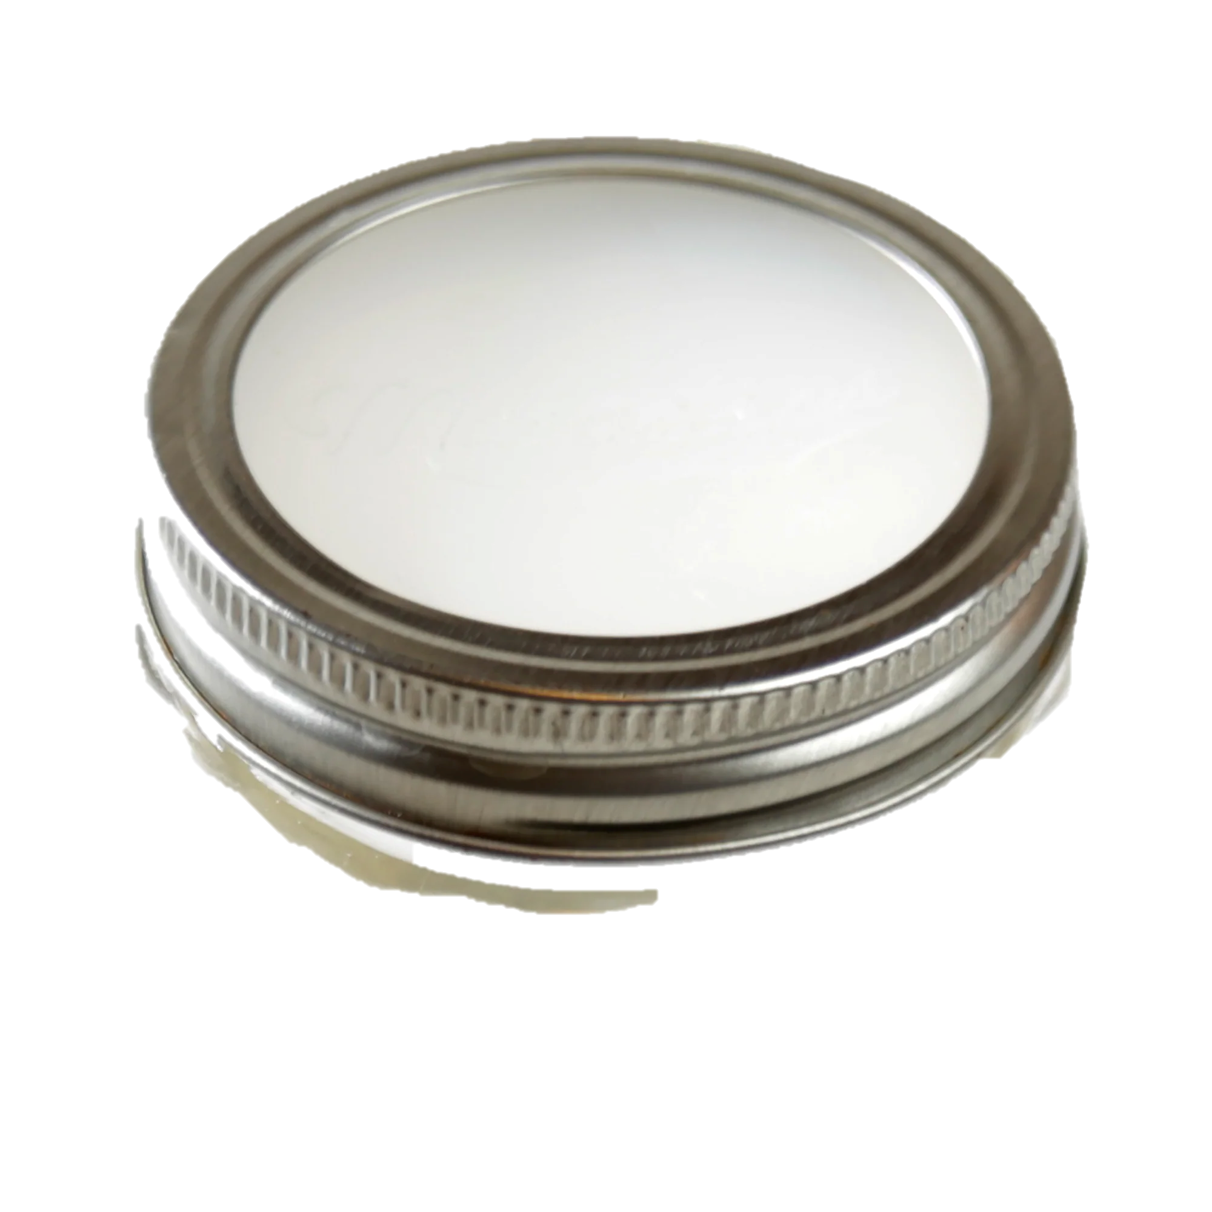
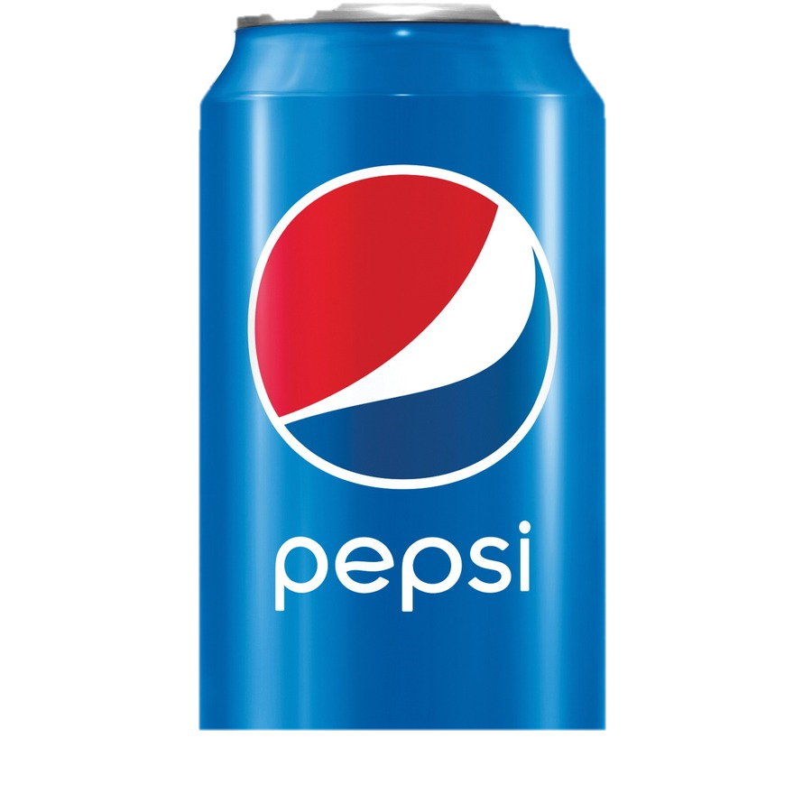
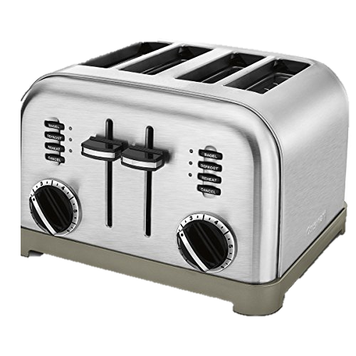
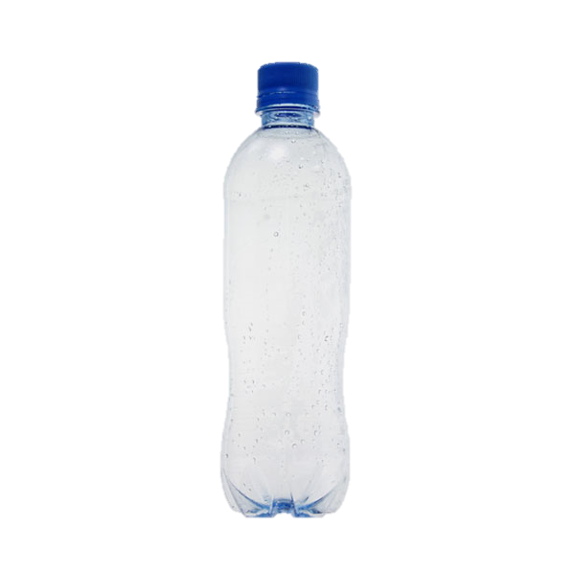
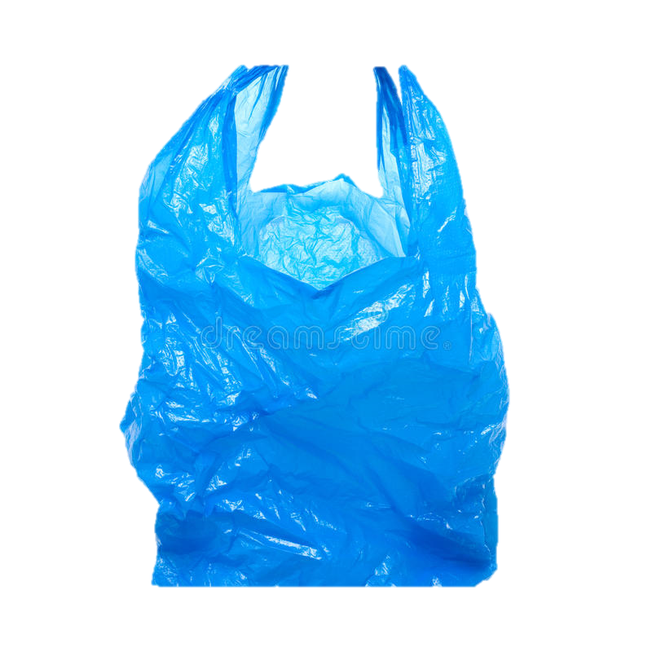
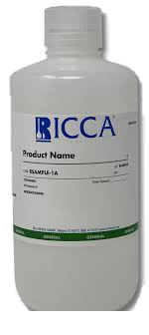

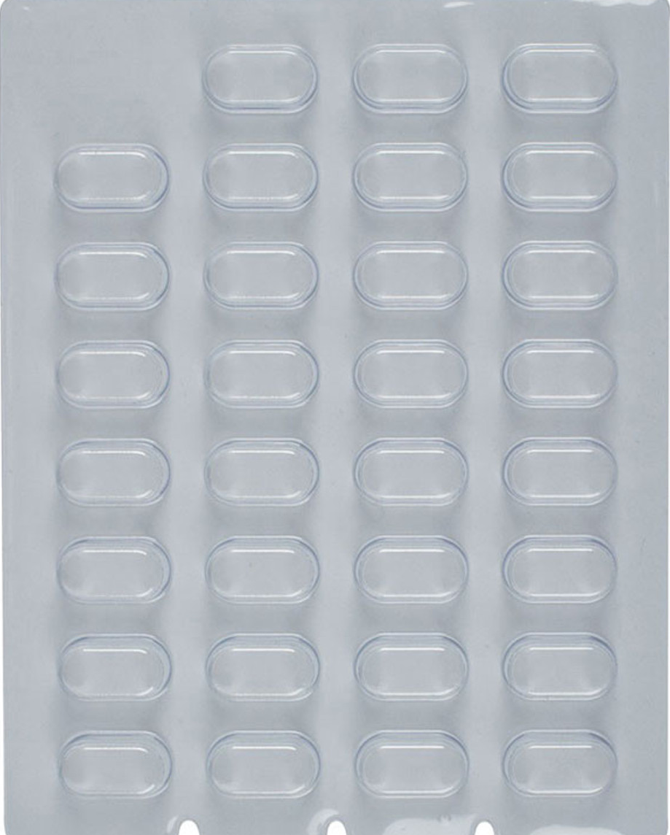
Put in
Not put in
Aluminum foil
Jar lid
Drink can
Battery
Appliance
Pain/Varnish can
Plastic bottle
Milk Carton
Plastic Bag
Electronics
Chemical packaging
Medication packaging
Tuyen Nguyen, Dept. Computer Science, Southeast Missouri State University
SEMO Student Research Conference, April 2023

Slide 15

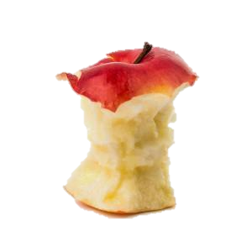
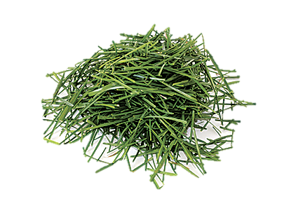
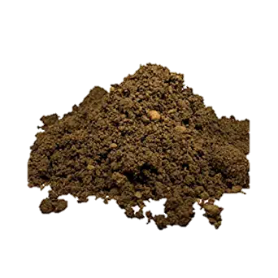
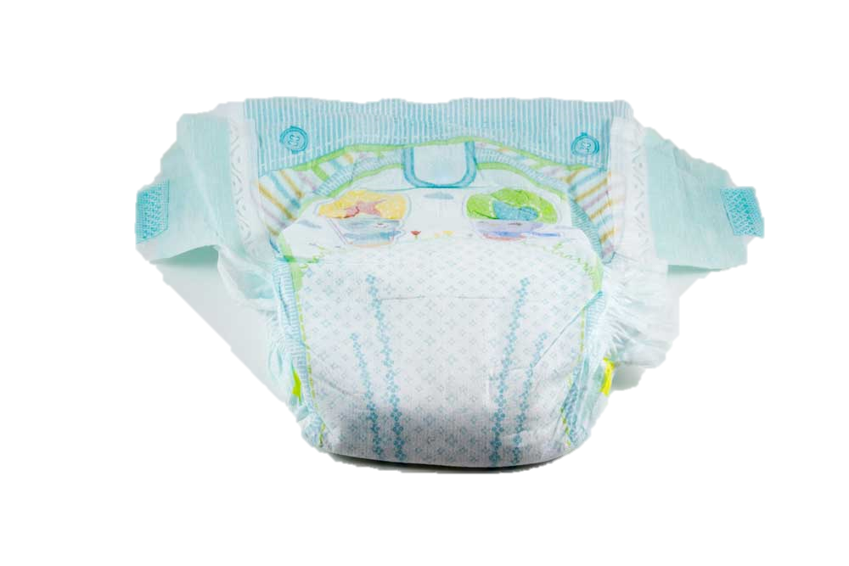
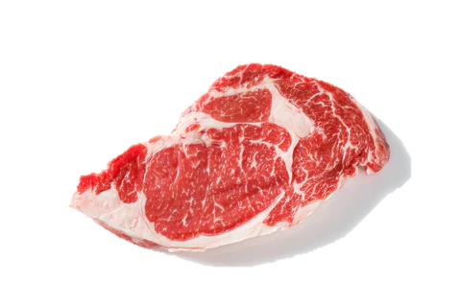
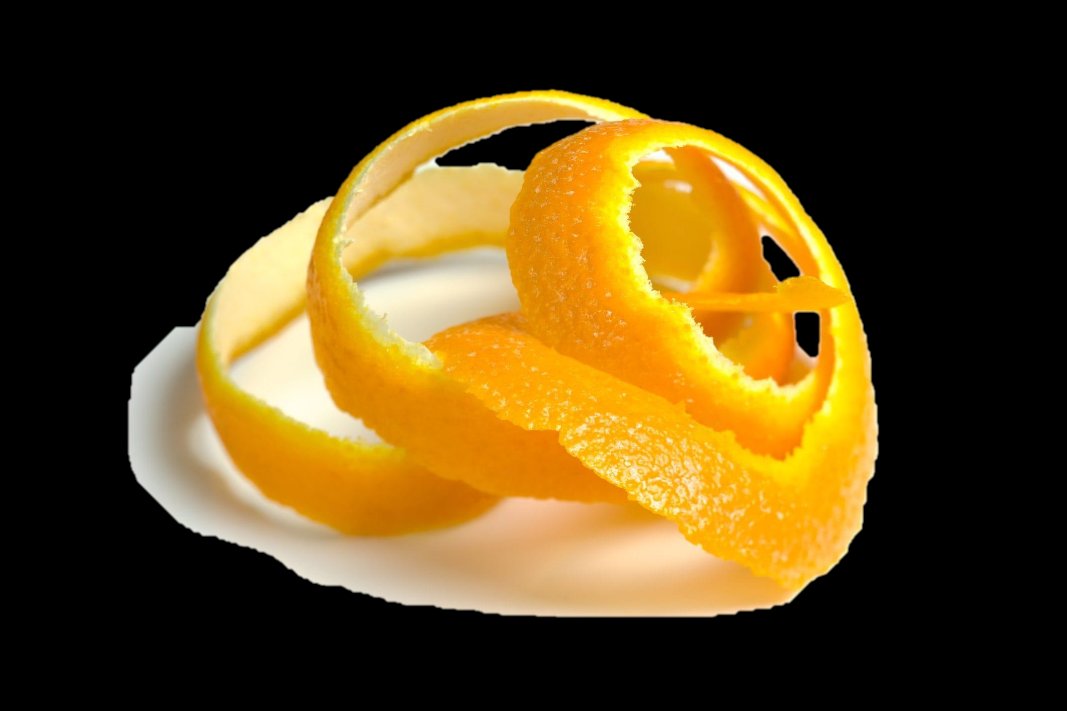
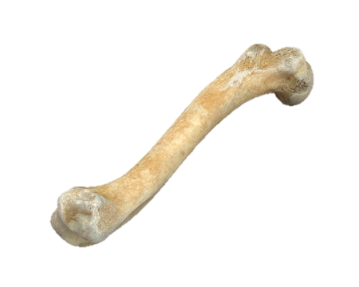
Put in
Not put in
Food waste
Veggie/fruit peeling
Grass Clipping
Soil
Hygiene
product
Raw meat
Used tissue
paper towel
Animal Bone
Tuyen Nguyen, Dept. Computer Science, Southeast Missouri State University
SEMO Student Research Conference, April 2023

Slide 16
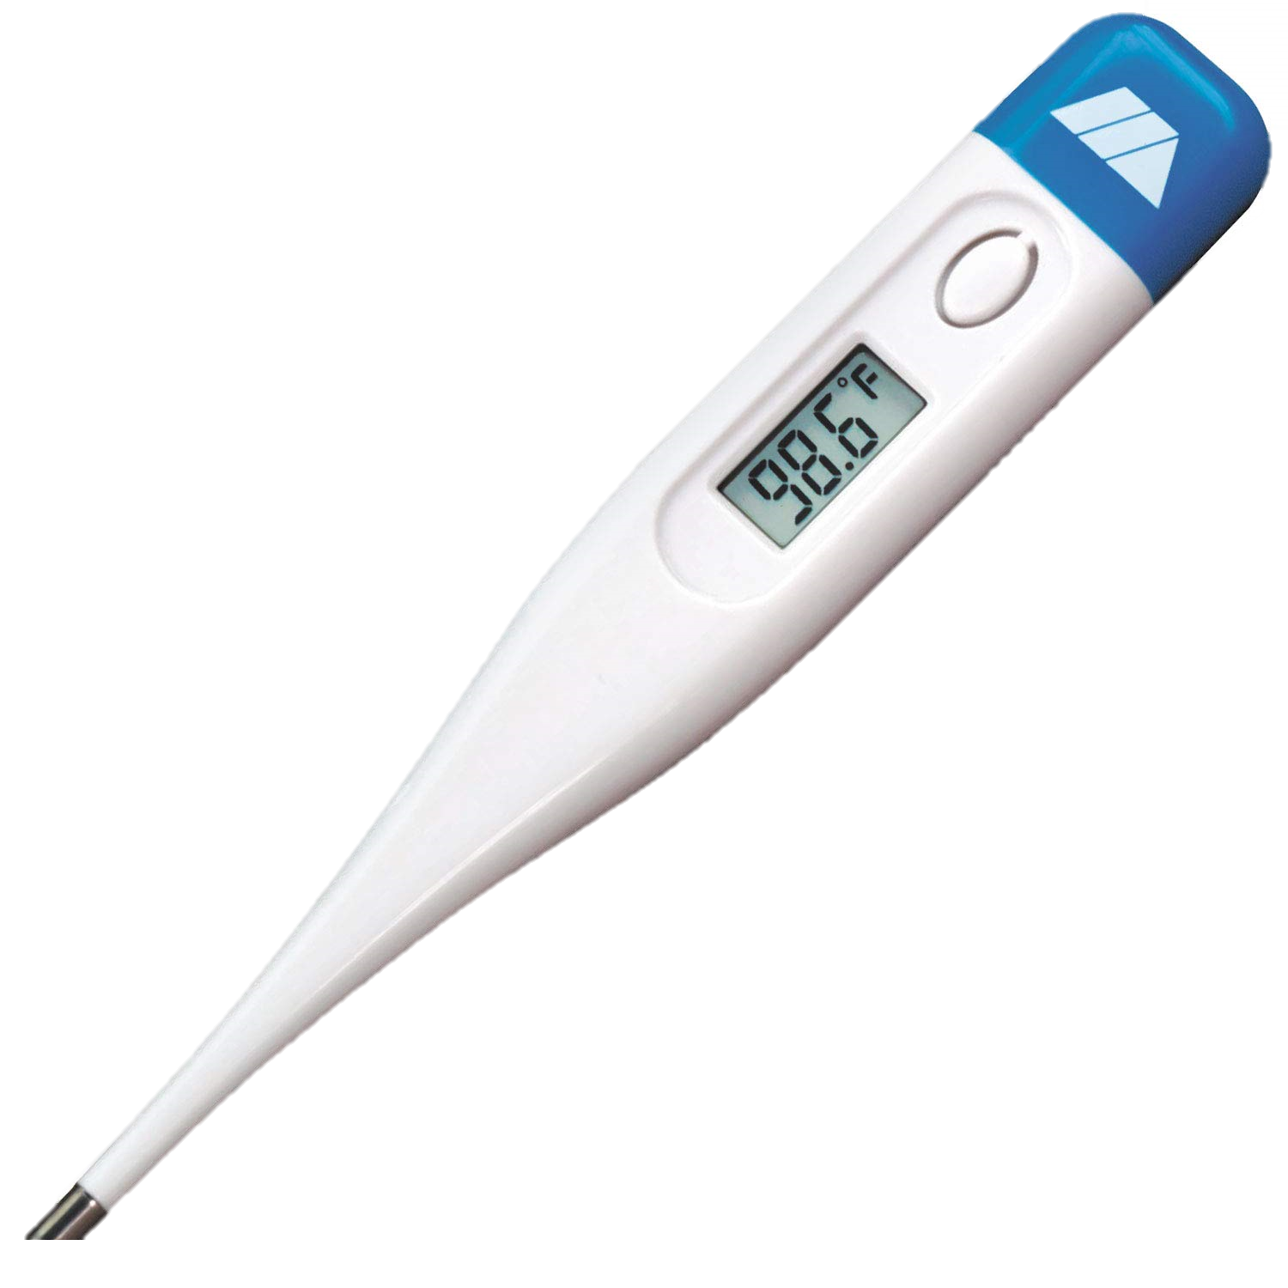
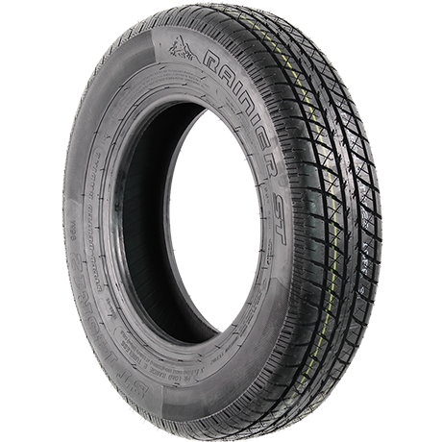
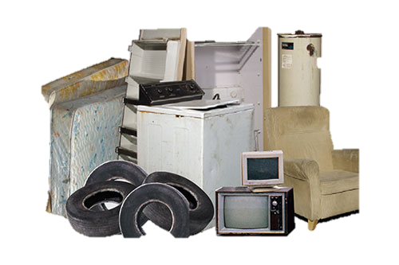
Other
Battery
Pain/Varnish can
Light bulb
Thermometer
Chemical packaging
Medication packaging
Appliance
Electronics
Bulky waste
Tire
Tuyen Nguyen, Dept. Computer Science, Southeast Missouri State University
SEMO Student Research Conference, April 2023

Slide 17

Oily paper
Hygiene
product
Chemical packaging
Raw meat
Animal Bone
Candle glass
Ceramics
Porcelain
Tempered glass tableware
Heat resistant glass
Crystal glassware
Tuyen Nguyen, Dept. Computer Science, Southeast Missouri State University
SEMO Student Research Conference, April 2023

Slide 18

1. Data collection TrashNet Dataset (collected by Gary Thung and Mindy Yang)
Photos are taken on a white posterboard and using sunlight /room lightning.
The dataset are downloaded and mapped to our project classes
TrashNet label | My project’s label
Plastic | Metals and Plastics
Metal | Metals and Plastics
Paper | Paper
Cardboard | Paper
Glass | Glass
Tuyen Nguyen, Dept. Computer Science, Southeast Missouri State University
SEMO Student Research Conference, April 2023

Slide 19

1. Data collection DrinkingWaste Dataset (collected by Arkadiy Serezhkin)
The dataset contains 4 classes of drinking waste:
Drinking Waste label | My project’s label
Aluminum Cans | Metals and Plastics
PET (plastic) bottles | Metals and Plastics
HDPE (plastic) Milk bottles | Metals and Plastics
Glass bottles | Glass
Tuyen Nguyen, Dept. Computer Science, Southeast Missouri State University
SEMO Student Research Conference, April 2023

Slide 20



2. Data collection Taco Dataset (by Pedro Proença, http://tacodataset.org/)
Photos taken under various environments: from tropical beaches to London street.
Bounding box is used to crop the trash instance from the image.
The dataset contains 60 categories (cigarette, lids, can, glass jar, e.g. ) -> Remap into 7 waste categories.
Tuyen Nguyen, Dept. Computer Science, Southeast Missouri State University
SEMO Student Research Conference, April 2023
Notes:
Each image contain multiple trash instances. Each trash instance contains bounding box. ->

Slide 21

Data collection From Google Image (collected by the project’s author)
Specified keywords in bio, glass, paper, other, non-recyclable
Downloaded images using a Python open-source Web Scraper coded by Jayden Oh Yicong
Verified Images
Tuyen Nguyen, Dept. Computer Science, Southeast Missouri State University
SEMO Student Research Conference, April 2023
Notes:
Each image contain multiple trash instances. Each trash instance contains bounding box. ->

Slide 22

Data collection Image Distribution
Tuyen Nguyen, Dept. Computer Science, Southeast Missouri State University
SEMO Student Research Conference, April 2023
Notes:
Each image contain multiple trash instances. Each trash instance contains bounding box. ->

Slide 23

Data collection Variation in Image Size
Tuyen Nguyen, Dept. Computer Science, Southeast Missouri State University
SEMO Student Research Conference, April 2023
Notes:
Each image contain multiple trash instances. Each trash instance contains bounding box. ->

Slide 24

Resize Image to 224x224 resolution Downscale by resizing and upscale by zero-padding
Tuyen Nguyen, Dept. Computer Science, Southeast Missouri State University
SEMO Student Research Conference, April 2023
Notes:
Each image contain multiple trash instances. Each trash instance contains bounding box. ->

Slide 25
Train – Validation – Test split 80/10/10 split – random stratified split
Category | Image Count
Bio | 608
Glass | 1920
Metals and plastic | 5816
Non recyclable | 2768
Other | 1624
Paper | 1904
Unknown | 1280
Category | Image Count
Bio | 76
Glass | 240
Metals and plastic | 727
Non recyclable | 346
Other | 203
Paper | 238
Unknown | 160
Category | Image Count
Bio | 67
Glass | 235
Metals and plastic | 720
Non recyclable | 346
Other | 196
Paper | 236
Unknown | 154
Training dataset (80%): is used by a neural network model to learn features for the classification tasks.
Validation dataset (10%): is used by the training process to tune hyperparameters (learning rate, dropout rate, so on …)
Testing dataset (10%): is unseen data by the model, used to measure the model’s performance.
Tuyen Nguyen, Dept. Computer Science, Southeast Missouri State University
SEMO Student Research Conference, April 2023
Notes:
Each image contain multiple trash instances. Each trash instance contains bounding box. ->

Slide 26


Images Count by Waste Categories Oversampling for a balanced dataset
Was Imbalanced
High bias towards the majority class
Everything predicted as the majority class
Create a balanced dataset
under sample the majority classes
oversample the minority classes
Tuyen Nguyen, Dept. Computer Science, Southeast Missouri State University
SEMO Student Research Conference, April 2023
Notes:
Each image contain multiple trash instances. Each trash instance contains bounding box. ->

Slide 27


2. Training Transfer Learning | EfficientNet-V2-S
Transferred parameters from a pretrained model learned from ImageNet-1000
During training, freeze these layers
Not freeze this last fully connected layer, train this layer using our trash dataset
Learn 12,810 params out of 20,190,298
Tuyen Nguyen, Dept. Computer Science, Southeast Missouri State University
SEMO Student Research Conference, April 2023
Notes:
Convolutional layers extract low level features, such as edges, different type of shape

Slide 28


2. Training Transfer Learning | EfficientNet-V2-S
Convolutional layers learn the low-level features such as edges and shapes
These low-level features are often shared among objects
Model pretrained on ImageNet dataset is available in PyTorch
ImageNet dataset is big
Tuyen Nguyen, Dept. Computer Science, Southeast Missouri State University
SEMO Student Research Conference, April 2023
Notes:
Convolutional layers extract low level features, such as edges, different type of shape

Slide 29
2. Training Hyperparameters and Design
Data Augmentation (RandAug): increase dataset size
Early stopping: prevent model from overfitting
Keep the Dropout layer with p=0.2: help with overfitting
Use Adam optimizer: adaptive learning rate, require little to no tuning of learning rate
Tuyen Nguyen, Dept. Computer Science, Southeast Missouri State University
SEMO Student Research Conference, April 2023
Notes:
Each image contain multiple trash instances. Each trash instance contains bounding box. ->

Slide 30
2. Training Leverage GPU for faster training
Access to GPU from Computer Science department’s cyber range to train the model:
HP G9 Server
Tesla M40 GPU
32 Core CPU
64 GB of Memory
GPU reduces the training time.
Tuyen Nguyen, Dept. Computer Science, Southeast Missouri State University
SEMO Student Research Conference, April 2023
Notes:
Each image contain multiple trash instances. Each trash instance contains bounding box. ->

Slide 31

Result Confusion matrix
78% accuracy on the testing dataset
Tuyen Nguyen, Dept. Computer Science, Southeast Missouri State University
SEMO Student Research Conference, April 2023
Notes:
Each image contain multiple trash instances. Each trash instance contains bounding box. ->

Slide 32

Result Precision, Recall, F1 Score
precision = TP / (TP + FP)
A high precision means the model making few false positive predictions
Recall = TP / (TP+FN)
A high recall means the model making feel false negative predictions
F1 score = 2 * (precision * recall) / (precision + recall)
F1 score is a metric that combines precision and recall to give an overall assessment of a model performances
Tuyen Nguyen, Dept. Computer Science, Southeast Missouri State University
SEMO Student Research Conference, April 2023
Notes:
Each image contain multiple trash instances. Each trash instance contains bounding box. ->

Slide 33





Result Precision, Recall, F1 Score
Low Precision (high number of false positive) in non recyclable and unknown:
We have little data for these classes
Trash instances that are degraded, so the model assigns to unknown
Low Recall (high number of false negative) in bio, non recyclable and unknown:
We have little data for these classes
Tuyen Nguyen, Dept. Computer Science, Southeast Missouri State University
SEMO Student Research Conference, April 2023
Notes:
Each image contain multiple trash instances. Each trash instance contains bounding box. ->

Slide 34

Future work
Collected more data
Create a robots -> grasp the object and put the object correct bin
Tuyen Nguyen, Dept. Computer Science, Southeast Missouri State University
SEMO Student Research Conference, April 2023
Notes:
Each image contain multiple trash instances. Each trash instance contains bounding box. ->

Slide 35
References
Law, K. L., Starr, N., Siegler, T. R., Jambeck, J. R., Mallos, N. J., & Leonard, G. H. (2020). The United States’ contribution of plastic waste to land and ocean. Science advances, 6(44), eabd0288.
Majchrowska, S., Mikołajczyk, A., Ferlin, M., Klawikowska, Z., Plantykow, M. A., Kwasigroch, A., & Majek, K. (2022). Deep learning-based waste detection in natural and urban environments. Waste Management, 138, 274-284.
Joy, A., Sherry Jr, J. F., Venkatesh, A., Wang, J., & Chan, R. (2012). Fast fashion, sustainability, and the ethical appeal of luxury brands. Fashion theory, 16(3), 273-295.
Tuyen Nguyen, Dept. Computer Science, Southeast Missouri State University
SEMO Student Research Conference, April 2023
Notes:
In the mid 2010s,

Slide 36
References
Proença, P. F., & Simoes, P. (2020). Taco: Trash annotations in context for litter detection. arXiv preprint arXiv:2003.06975.
Roach, B., Goodwin, N., & Nelson, J. (2019). Consumption and the consumer society. Medford, MA.: Global Development and Environment Institute, Tufts University. Recuperado de https://www. bu. edu/eci/files/2019/10/Consumption_and_Consumer_Society. pdf.
Shui, S., & Plastina, A. (2013). World apparel fiber consumption survey. FAO and ICAC, Tech. Rep.
Serezhkin, Arkadiy. 2020. “Drinking Waste Classification.” https://www.kaggle.com/arkadiyhacks/drinking-waste- classification; Kaggle.
Textiles, E. P. A. Material-Specific Data.
Tuyen Nguyen, Dept. Computer Science, Southeast Missouri State University
SEMO Student Research Conference, April 2023
Notes:
In the mid 2010s,

Slide 37
References
Tonjes, D. J., Aphale, O., Clark, L., & Thyberg, K. L. (2018). Conversion from dual stream to single stream recycling results in nuanced effects on revenues and waste stream amounts and composition.
Resources, Conservation and Recycling, 138, 151-159.
US Environmental Protection Agency (EPA). (2020). National overview: Facts and figures on materials, wastes and recycling.
Yang, M., Thung, G., 2016. TrashNet. GitHub Repository. https://github.com/garythung/trashnet; GitHub.
.
Tuyen Nguyen, Dept. Computer Science, Southeast Missouri State University
SEMO Student Research Conference, April 2023
Notes:
In the mid 2010s,

Slide 38

A trash classifier web app:
Tuyen Nguyen, Dept. Computer Science, Southeast Missouri State University
SEMO Student Research Conference, April 2023
Notes:
Each image contain multiple trash instances. Each trash instance contains bounding box. ->

Slide 39

https://trash-classifier-webapp.herokuapp.com/
Tuyen Nguyen, Dept. Computer Science, Southeast Missouri State University
SEMO Student Research Conference, April 2023
Notes:
Each image contain multiple trash instances. Each trash instance contains bounding box. ->

